Slide 1
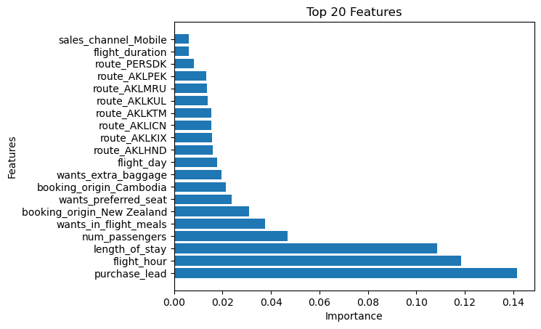
Predicting customer buying behavior
Random Forest Classifier with optimized hyperparameters
Mean score of the classifier is 85%
Visualization: bar chart describing top 20 features and their importance values

